Slide 1

Lab 1

Slide 2
Outline
Background Info on Clion
Install Clion
Clion Basic Functionalities
Create projects
Add files to a project
Compile and run C programs
In class Exercise
Debug with CLion

Slide 3
Background Info on CLion
Popular Integrated Development Environment (IDE)
Provides graphical tools for coding, building, running and debugging applications
Free and Open Source cross-platform IDE that supports multiple compilers including GCC , Clang and Visual C++Open Source
It has being developed for Windows, Linux and macOS
It is a general purpose open platform that facilitates and encourages the development of third party plug-ins

Slide 4
Background Info on CLion
Popular Integrated Development Environment (IDE)
Provides graphical tools for coding, building, running and debugging applications
Free and Open Source cross-platform IDE that supports multiple compilers including GCC and CLang
It has been developed for Windows, Linux and MacOS
It is a general purpose open platform that facilitates and encourages the development of third party plug-ins

Slide 5
Background Info on CLion
Popular Integrated Development Environment (IDE)
Provides graphical tools for coding, building, running and debugging applications
Free and Open Source cross-platform IDE that supports multiple compilers including GCC and CLang:
It has been developed for Windows, Linux and MacOS
It is a general-purpose open platform that facilitates and encourages the development of third-party plug-ins.

Slide 6
Install CLion

Slide 7
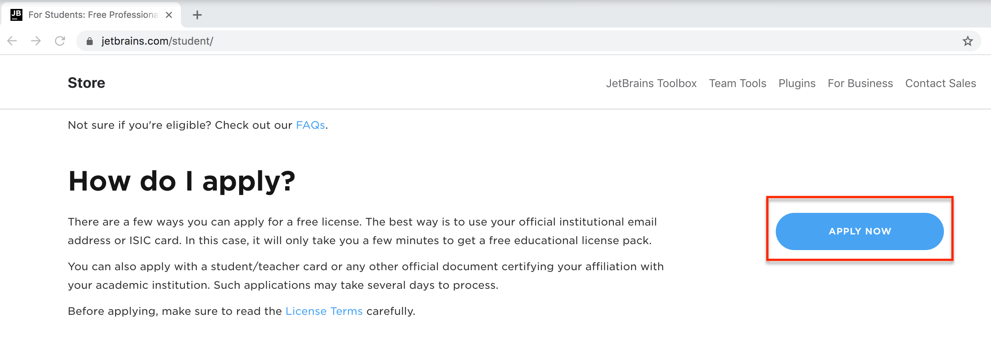
Obtain CLion
Apply for a student pack using your institutional email at: https://www.jetbrains.com/student/
Notes:
Modified Slide

Slide 8
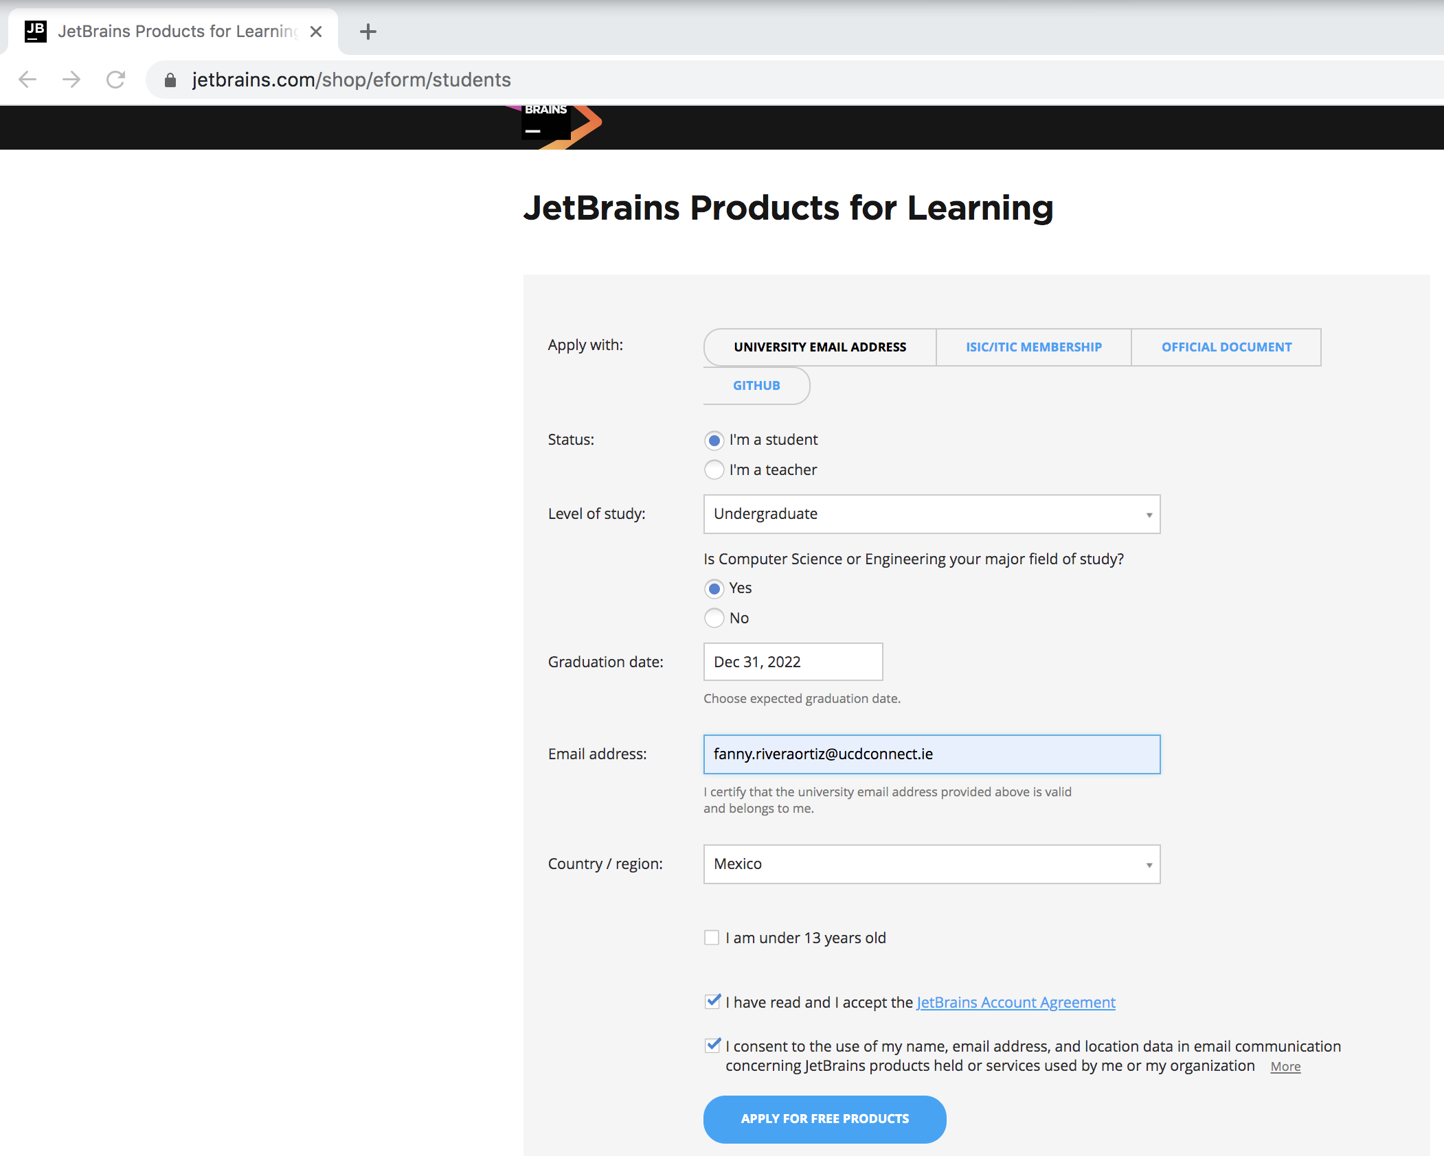
Obtain CLion
Fill out the details using your Student UCD email address at:
https://www.jetbrains.com/shop/eform/students
Notes:
Modified Slide

Slide 9
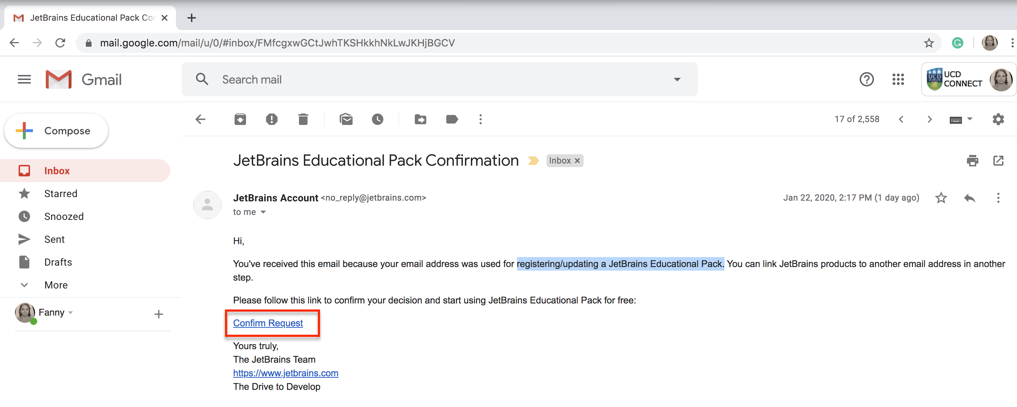
Obtain CLion
You will get a confirmation email to register a JetBrains Educational Pack.
Click on the Confirm Request Link.
Notes:
Modified Slide

Slide 10
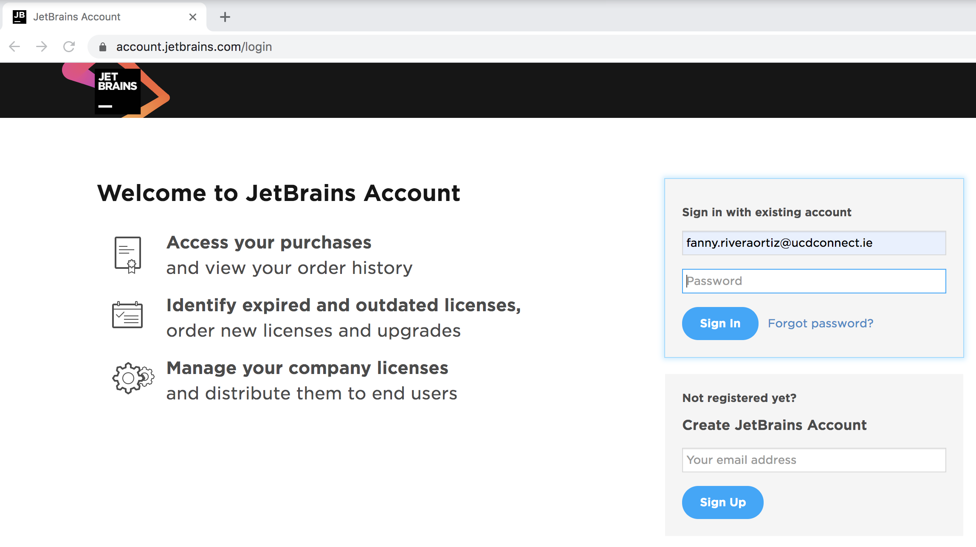
Obtain CLion
Connect to your JetBrains (JB) account at: https://account.jetbrains.com/login
Notes:
Modified Slide

Slide 11
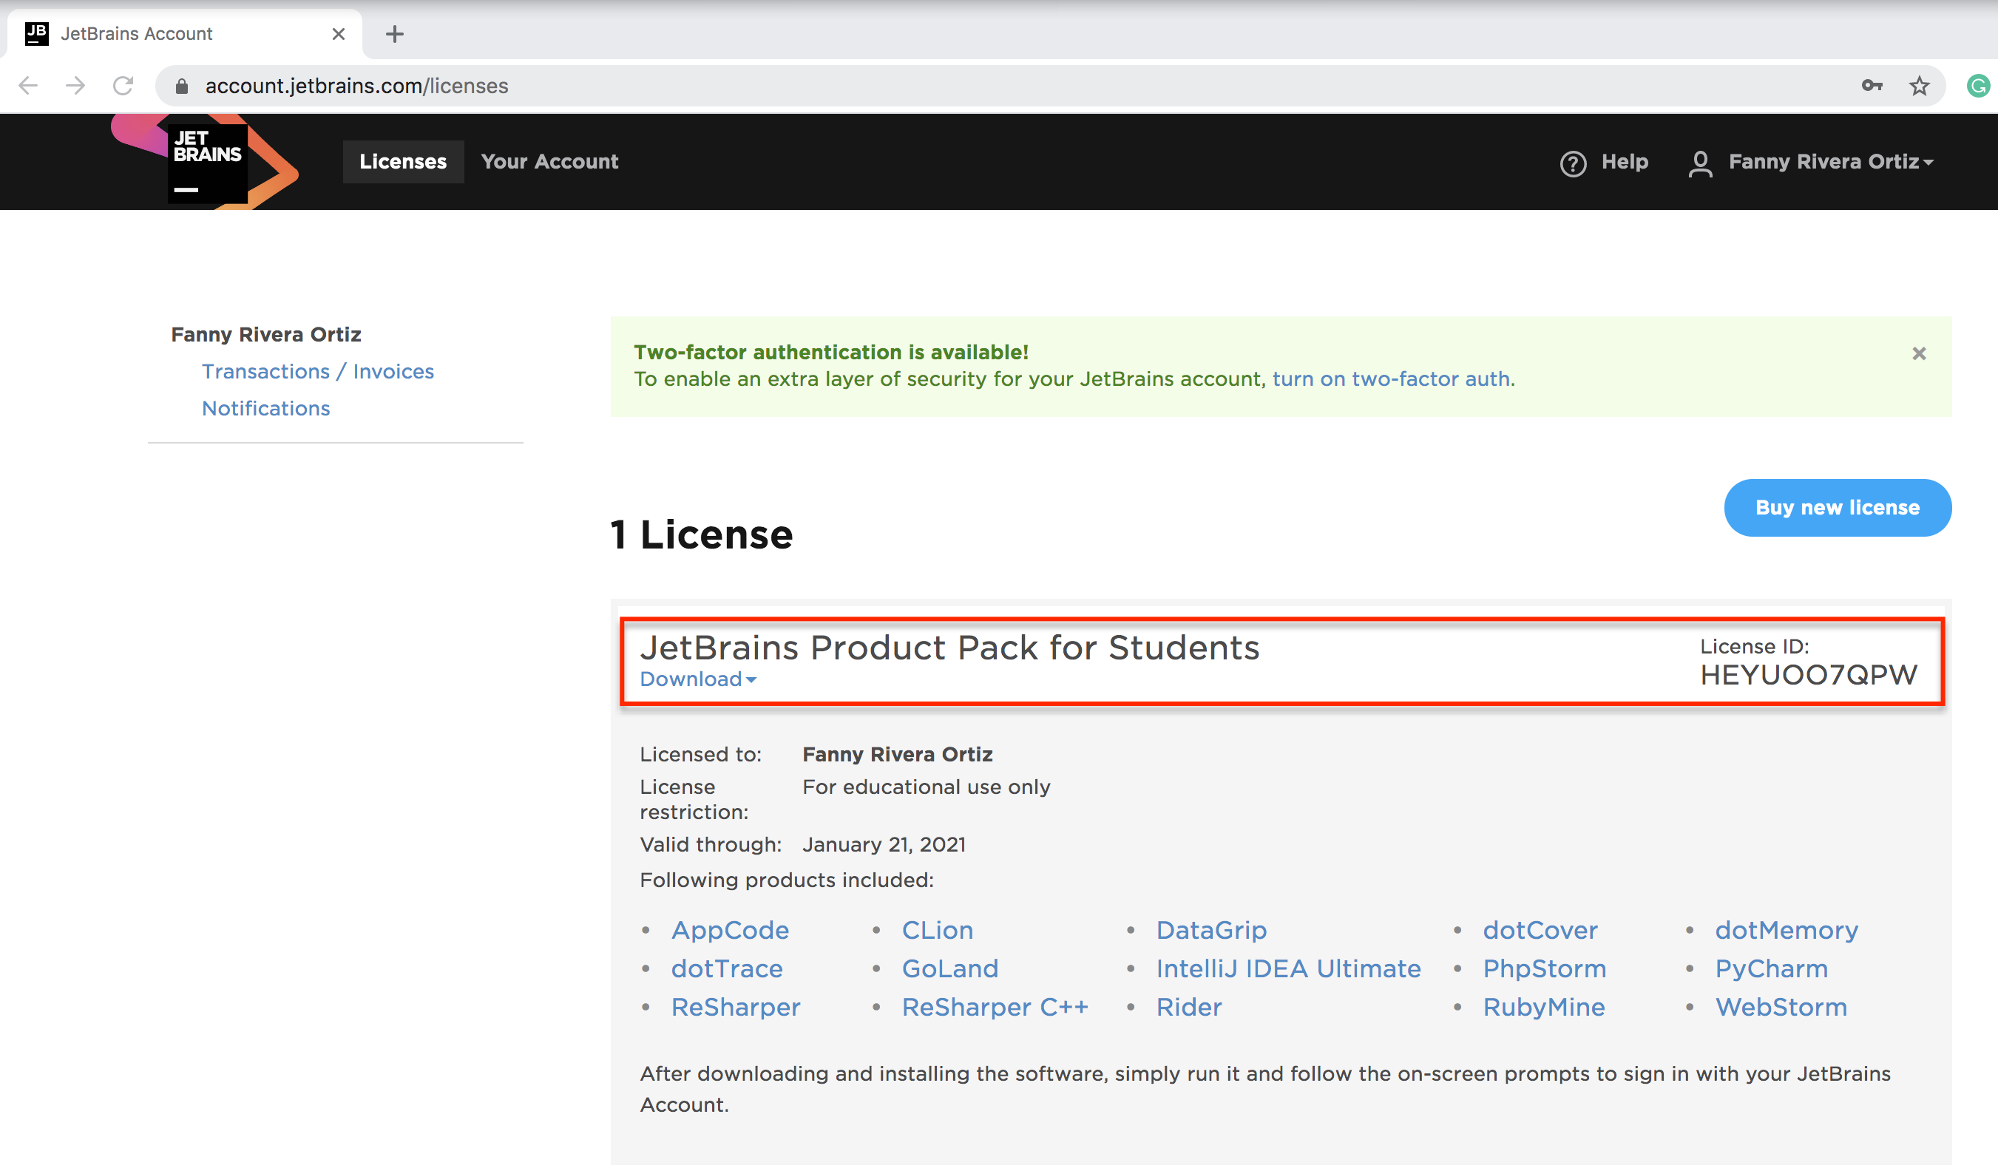
Obtain CLion
Make sure you have a license Id for a JetBrains Product Pack for Students at:
https://account.jetbrains.com/licenses
Notes:
Modified Slide

Slide 12
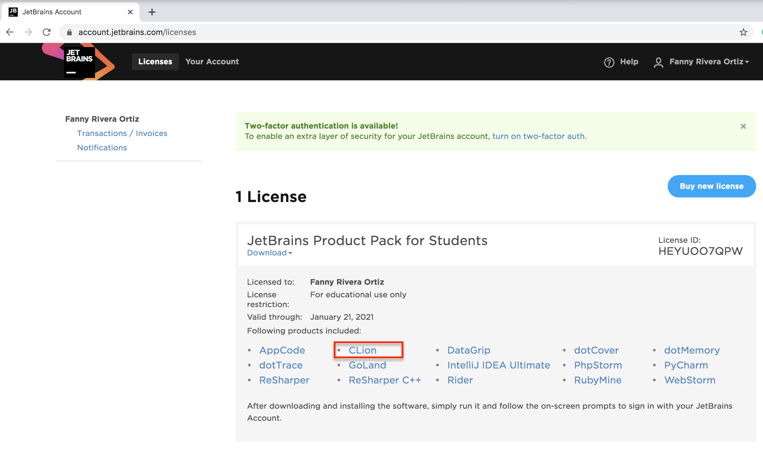
Obtain CLion
Click on CLIon.

Slide 13
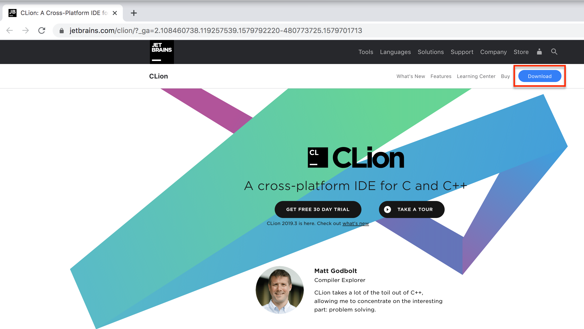
Install CLion
Click on the Download button

Slide 14
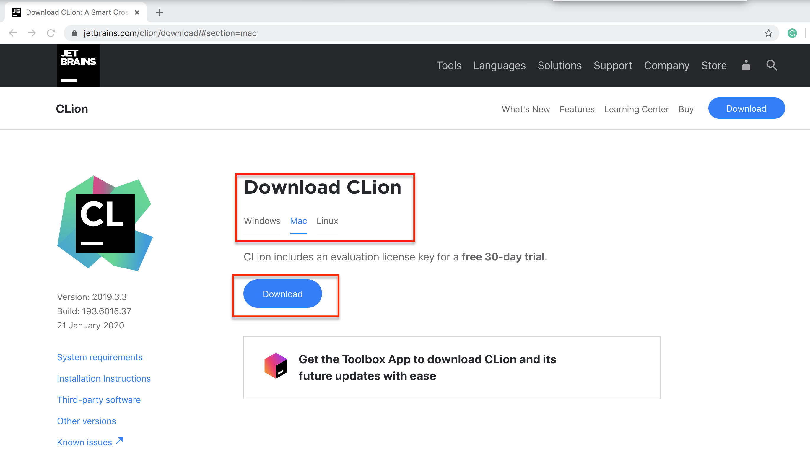
Install CLion
Run the installer (.exe on Windows, .dmg on MacOS) and follow the Wizard steps

Slide 15
Configure CLion

Slide 16
Toolchain Requirements
Ensure that you have one of these tools installed on your machine.
On Windows
MinGW OR MinGW64 ➔(slides 17-19)
Cygwin > v2.8 ➔ (slides 20-22)
On MacOS
XCode command line ➔ (slides 23-26)
On Linux
GCC/G++ or Clang

Slide 17
Configure CLion on Windows using MinGW/MinGW64

Slide 18
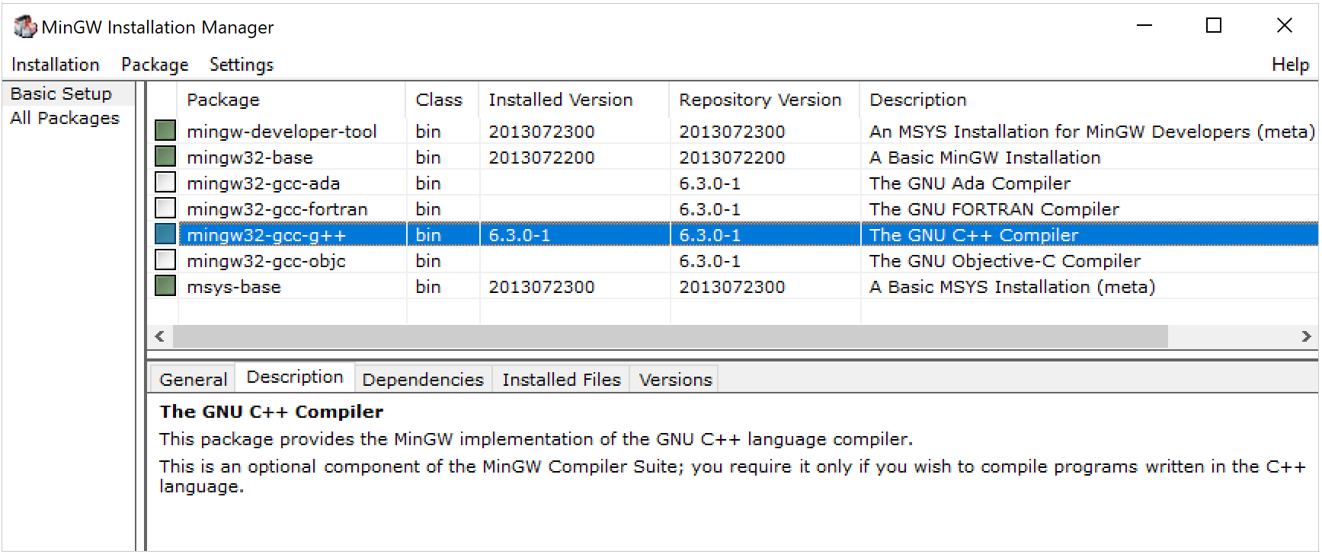
Installing MinGW/MinGW64
Download MinGW or MinGW64 installer
Run the installer and select the following packages in the Basic Setup list: mingw-developer-tool, mingw32-base, mingw32-gcc-g++, mingw32-msys-base
Notes:
You can run setup to install additional packages later

Slide 19
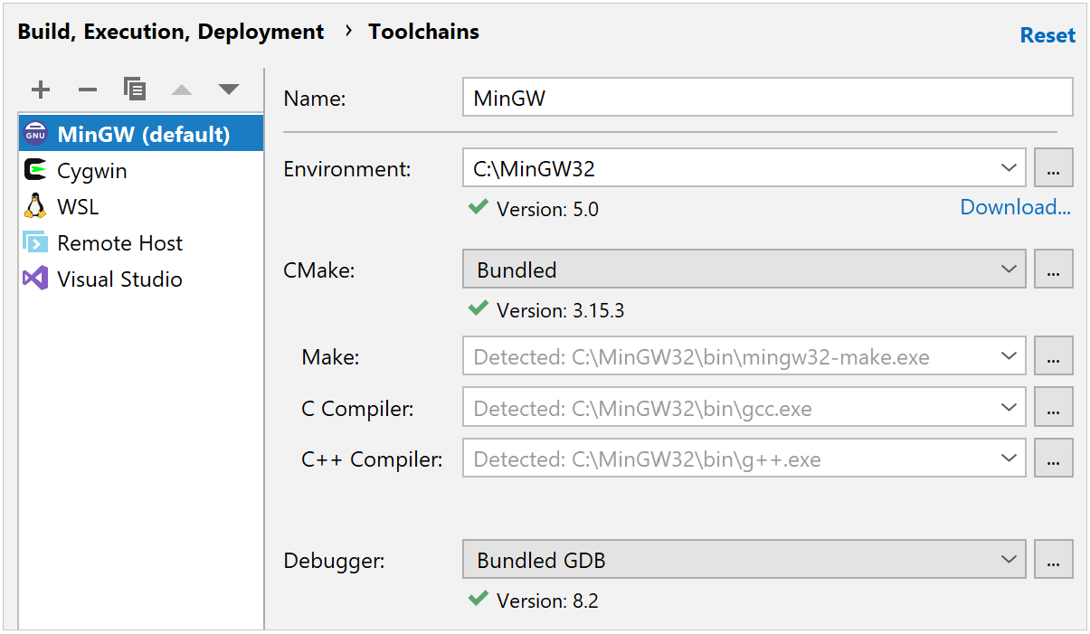
Configure CLion (MinGW/MinGW64)
Once the installation is finished, open Clion and go to File | Settings | Build, Execution, Deployment | Toolchains.
Select MinGW from the Environment list. CLion attempts to detect the MinGW installation automatically. Check the detection result, and specify the path manually if required.
Wait until the tools detection finishes. If CLion cannot detect compilers or make, double-check the installed packages in MinGW Installation Manager. Press Apply when all the tools are set correctly.
Notes:
You can run setup to install additional packages later

Slide 20
Configure CLion on Windows using CygWin

Slide 21
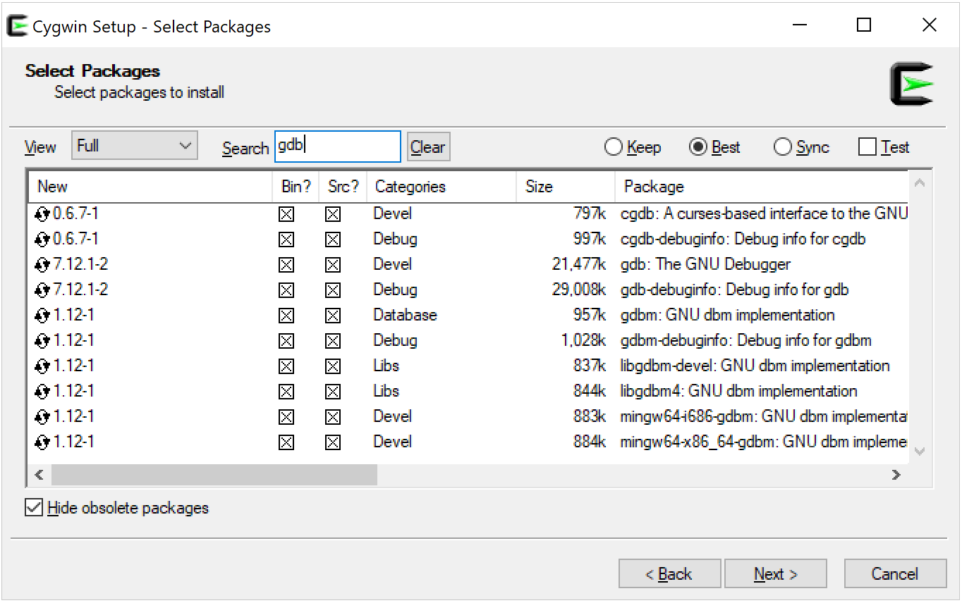
Install CygWin
Download the Cygwin installer v2.8 or later
Run the installer and select the following packages: gcc-g++, make, gdb
To select a package, type its name in the Search field and then click it in the list until a tick mark appears in the Bin? column
Notes:
You can run setup to install additional packages later

Slide 22
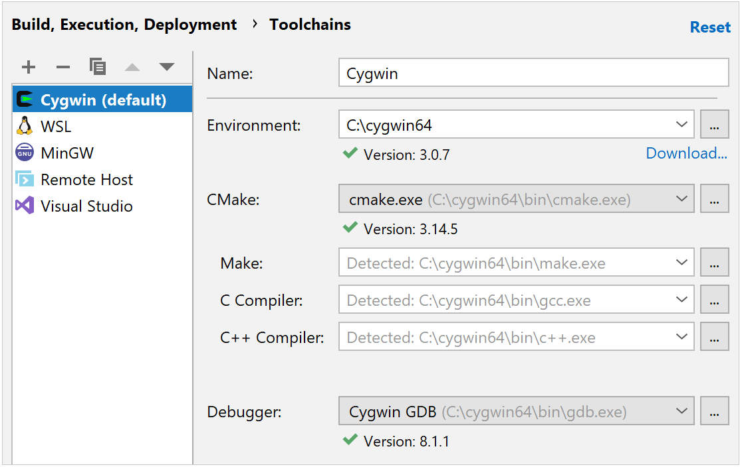
Configure CLion (Cygwin)
Once the installation is finished, open Clion and go to File | Settings | Build, Execution, Deployment | Toolchains.
Select Cygwin from the Environment list. CLion attempts to detect the Cygwin installation automatically. Check the detection result, and specify the path manually if required.
Wait until detection finishes, and press Apply.
Notes:
You can run setup to install additional packages later

Slide 23
Configure CLion on MacOS using XCode

Slide 24
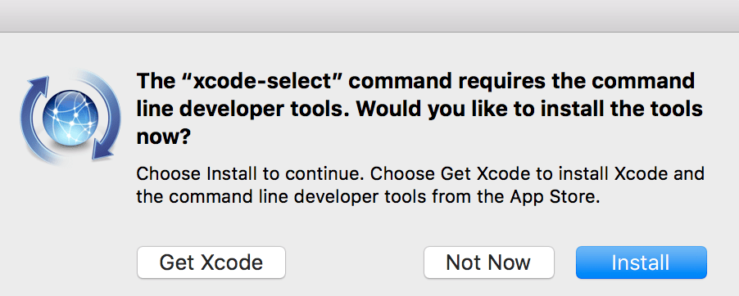
Install Xcode (1/3)
Open the terminal and run the following command:
xcode-select –install
When prompted to install command line developer tools, click the Install button:
Notes:
You can run setup to install additional packages later

Slide 25
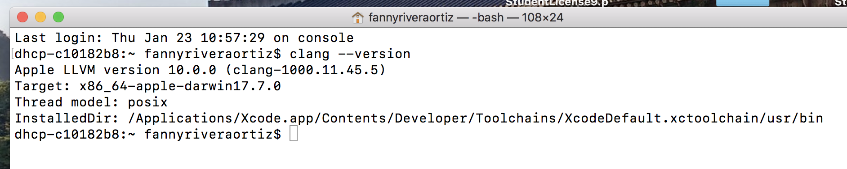
Install Xcode (2/3)
With Xcode command line tools, you get the Clang compiler installed by default. To check the compiler presence and its version, run on the terminal: clang --version
Notes:
You can run setup to install additional packages later

Slide 26
Install Xcode (3/3)
Command line tools may not update automatically along with the system or Xcode update.
This may cause error messages like invalid active developer path during project loading in CLion.
To fix this, run the same xcode-select --install command on the terminal, and the tools will be updated accordingly.
Notes:
You can run setup to install additional packages later

Slide 27
Create and Manage Projects

Slide 28
Projects
A project groups a set of related source and library files as well as configuration files.
Different types of projects depending on the objective
We will focus on C Executable projects
Mainly contain C source files created from scratch and compiled code
Each project is contained in a subdirectory inside a project location in your filesystem.

Slide 29
Create a New C Project

Slide 30
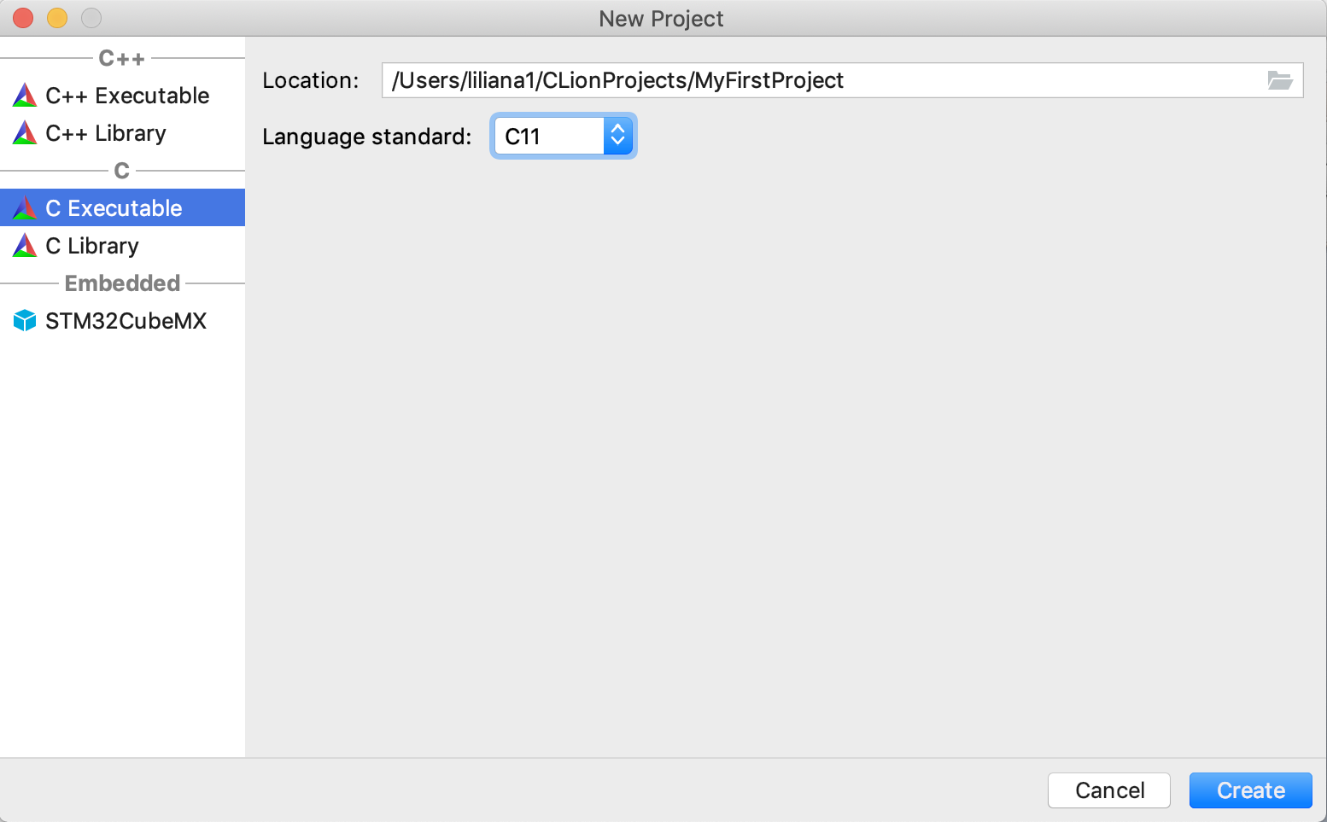
Create a New Project (1/2)
On the left pane, select the Project Type (C Executable)
Input a Location, i.e. directory where you want your project to be contained
Project name
C Language version
Project type

Slide 31
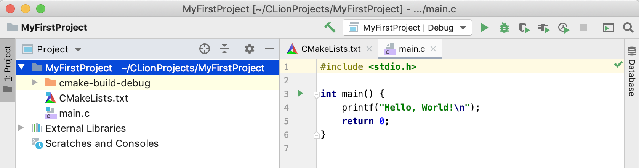
Create a New Project (2/2)
You can now see your project inside the workspace and the default source file (main.c) contains
Notes:
Modified

Slide 32
Add Files to Your Project

Slide 33
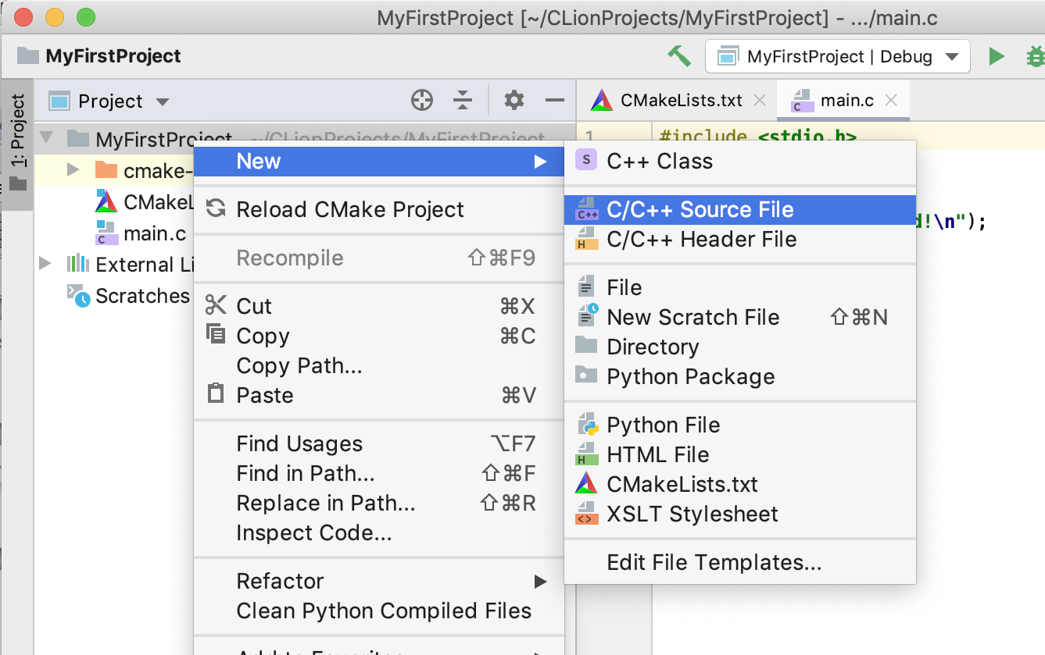
Add a new C Source File to the Project
Right-click on the Project and select New C/C++ Source File

Slide 34
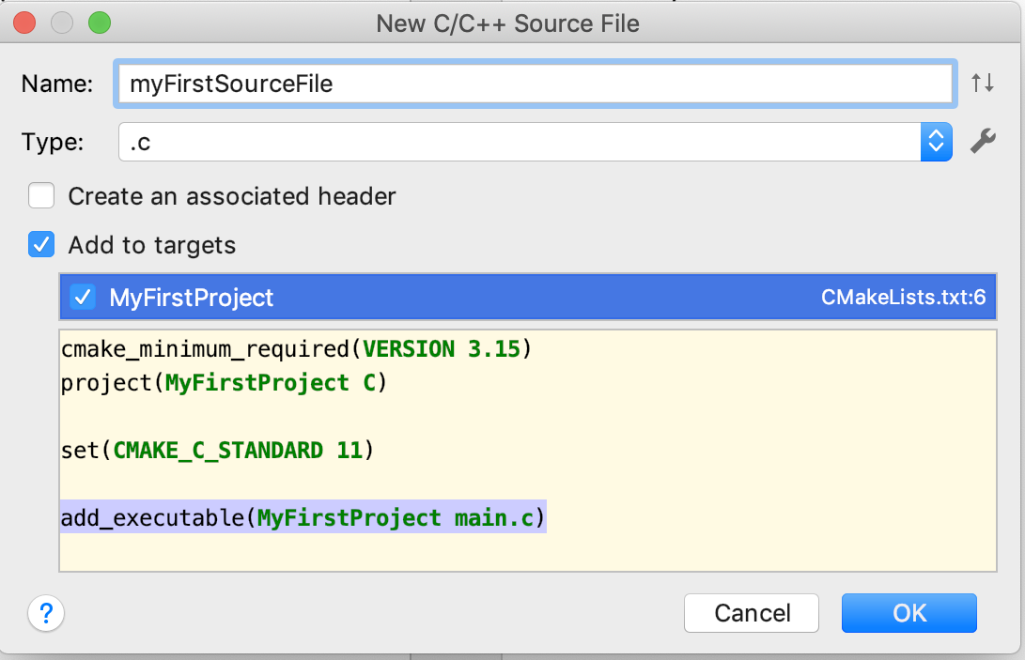
Creating a New C Source File
Provide the name of the file (e.g., myFirstSourceFile) and the type (.c)
Select OK

Slide 35
BrightSpace

Slide 36
Download Files
Connect to UCD BrightSpace at https://brightspace.ucd.ie/d2l/home/54656
Download from the Week 1 >> Lab 1 the following files:
factorial.c
example1.c
Notes:
Added

Slide 37
CLion IDE Components

Slide 38
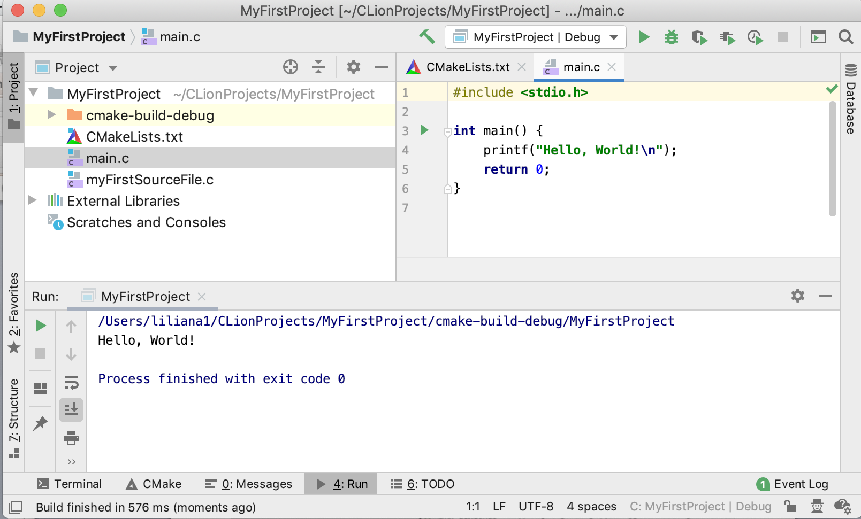
IDE Components
This pane allows visualizing/editing project elements
Notes:
Modified

Slide 39
IDE Components
Textual editor where you can write your program

Slide 40
IDE Components
Typically this contains a console and a list of compiler problems

Slide 41
Compile file main.c
Select the main file and press the Build Button
Notes:
Modified

Slide 42
Execute it
Click on the Run button
Notes:
Modified

Slide 43
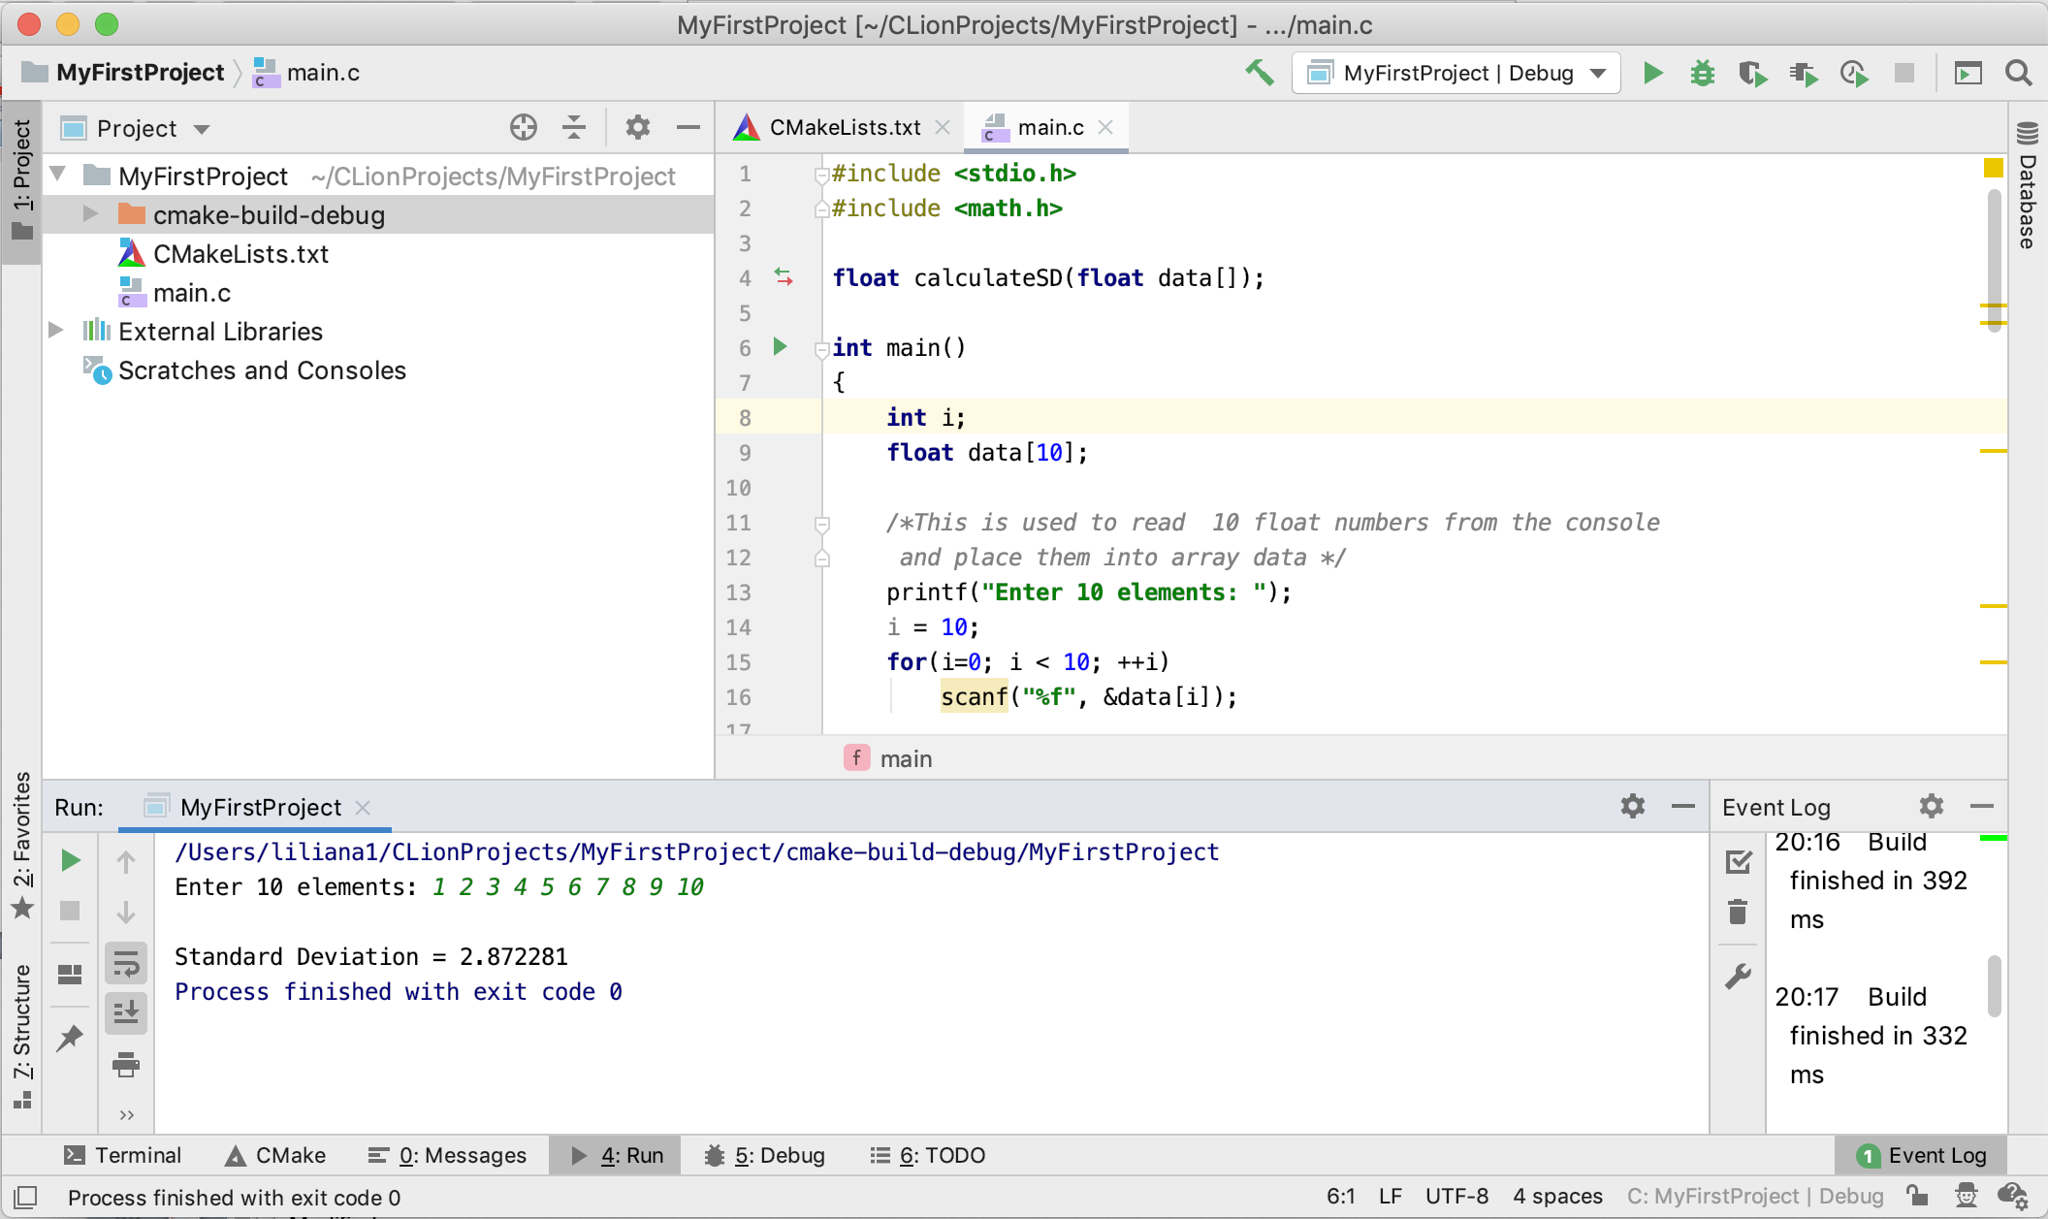
Try it yourself!
From BrightSpace, from the laboratory 1, download the example1.c file
Copy the content of file example1.c in your main.c file
Compile it and execute it
Notes:
Modified

Slide 44
Debugging

Slide 45
Debugging
As your programs become more complicated, there will be a need to trace the program execution step by step or place break points where you wish the program to pause.
A debugger can pause your program and you can watch the values of the variables that you have defined.

Slide 46
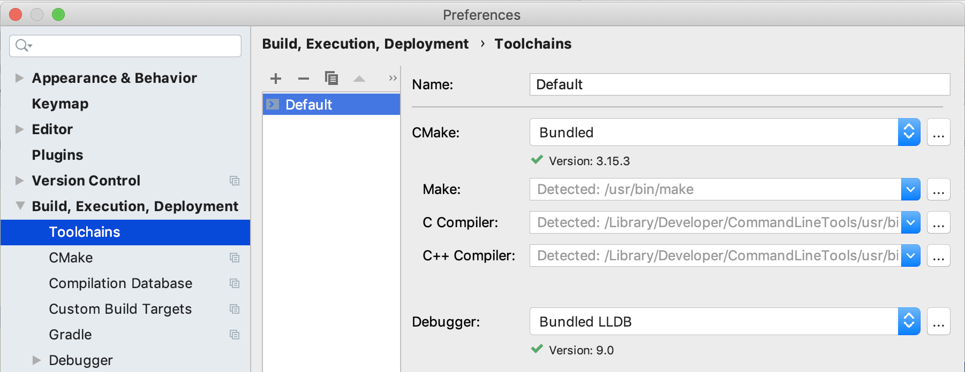
Prerequisites
Ensure that a debugger is configured in your toolchains.
Select Clion >> Preferences >> Build, Execution Deployment >> Toolchains >> Default
Notes:
Modified

Slide 47
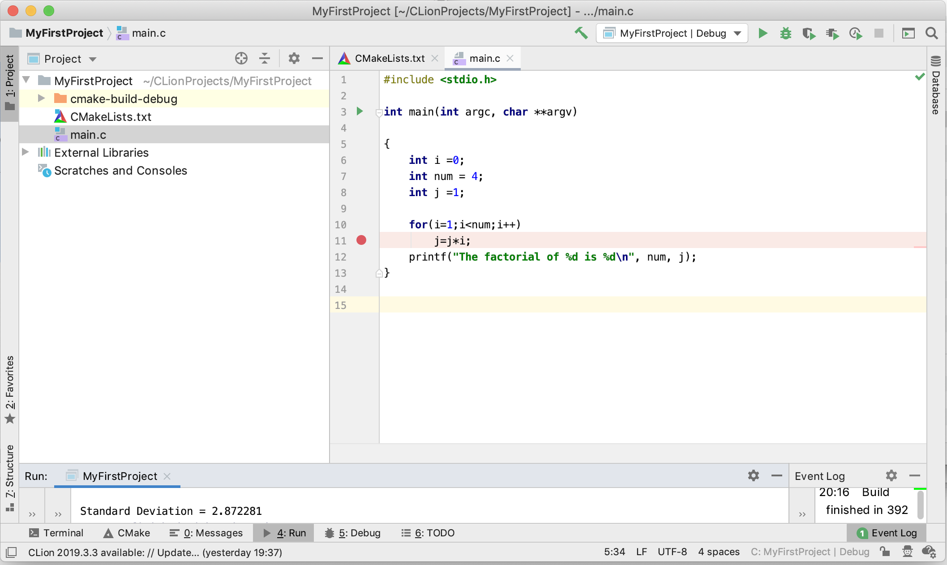
Debugging
From BrightSpace, from the laboratory 1, download the factorial.c file
Copy the content of file factorial.c in your main file.
Click on the left side for the line containing instruction
j = j*i;
A red circle will appear. This is called breakpoint.
A breakpoint indicates where you want to stop the execution of your program.
Notes:
Modified

Slide 48
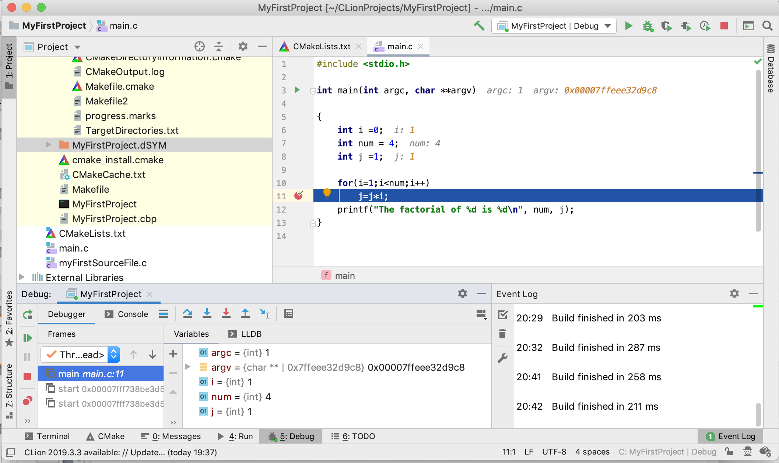
Debugging
Click on the debug button.
Notes:
Modified

Slide 49
Debugging
Click on LLDB
This will allow you to visualize the value of the variables every time the execution of the program is interrupted

Slide 50
Debugging
Press Resume Program
Notes:
Modified

Slide 51
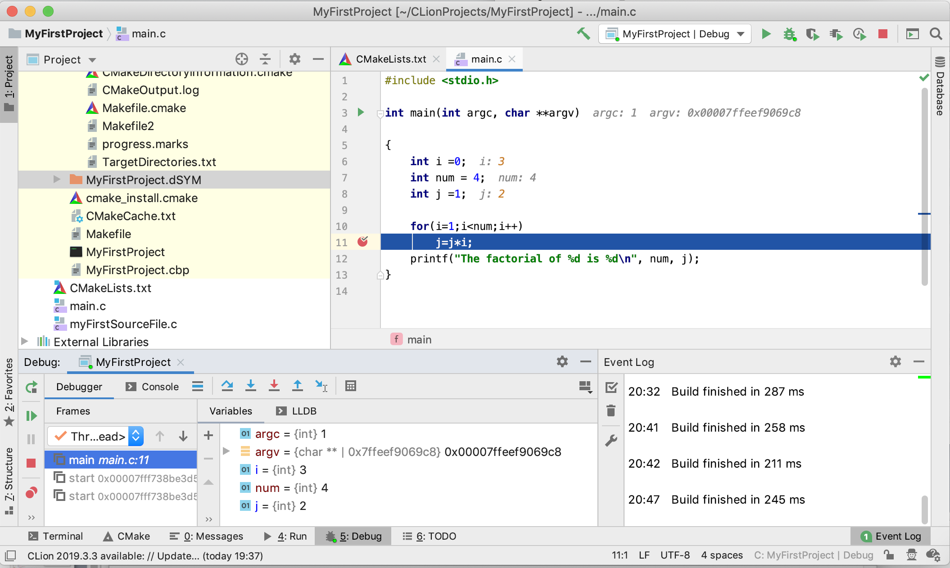
Debugging

Slide 52
Debugging
Press Resume Program

Slide 53
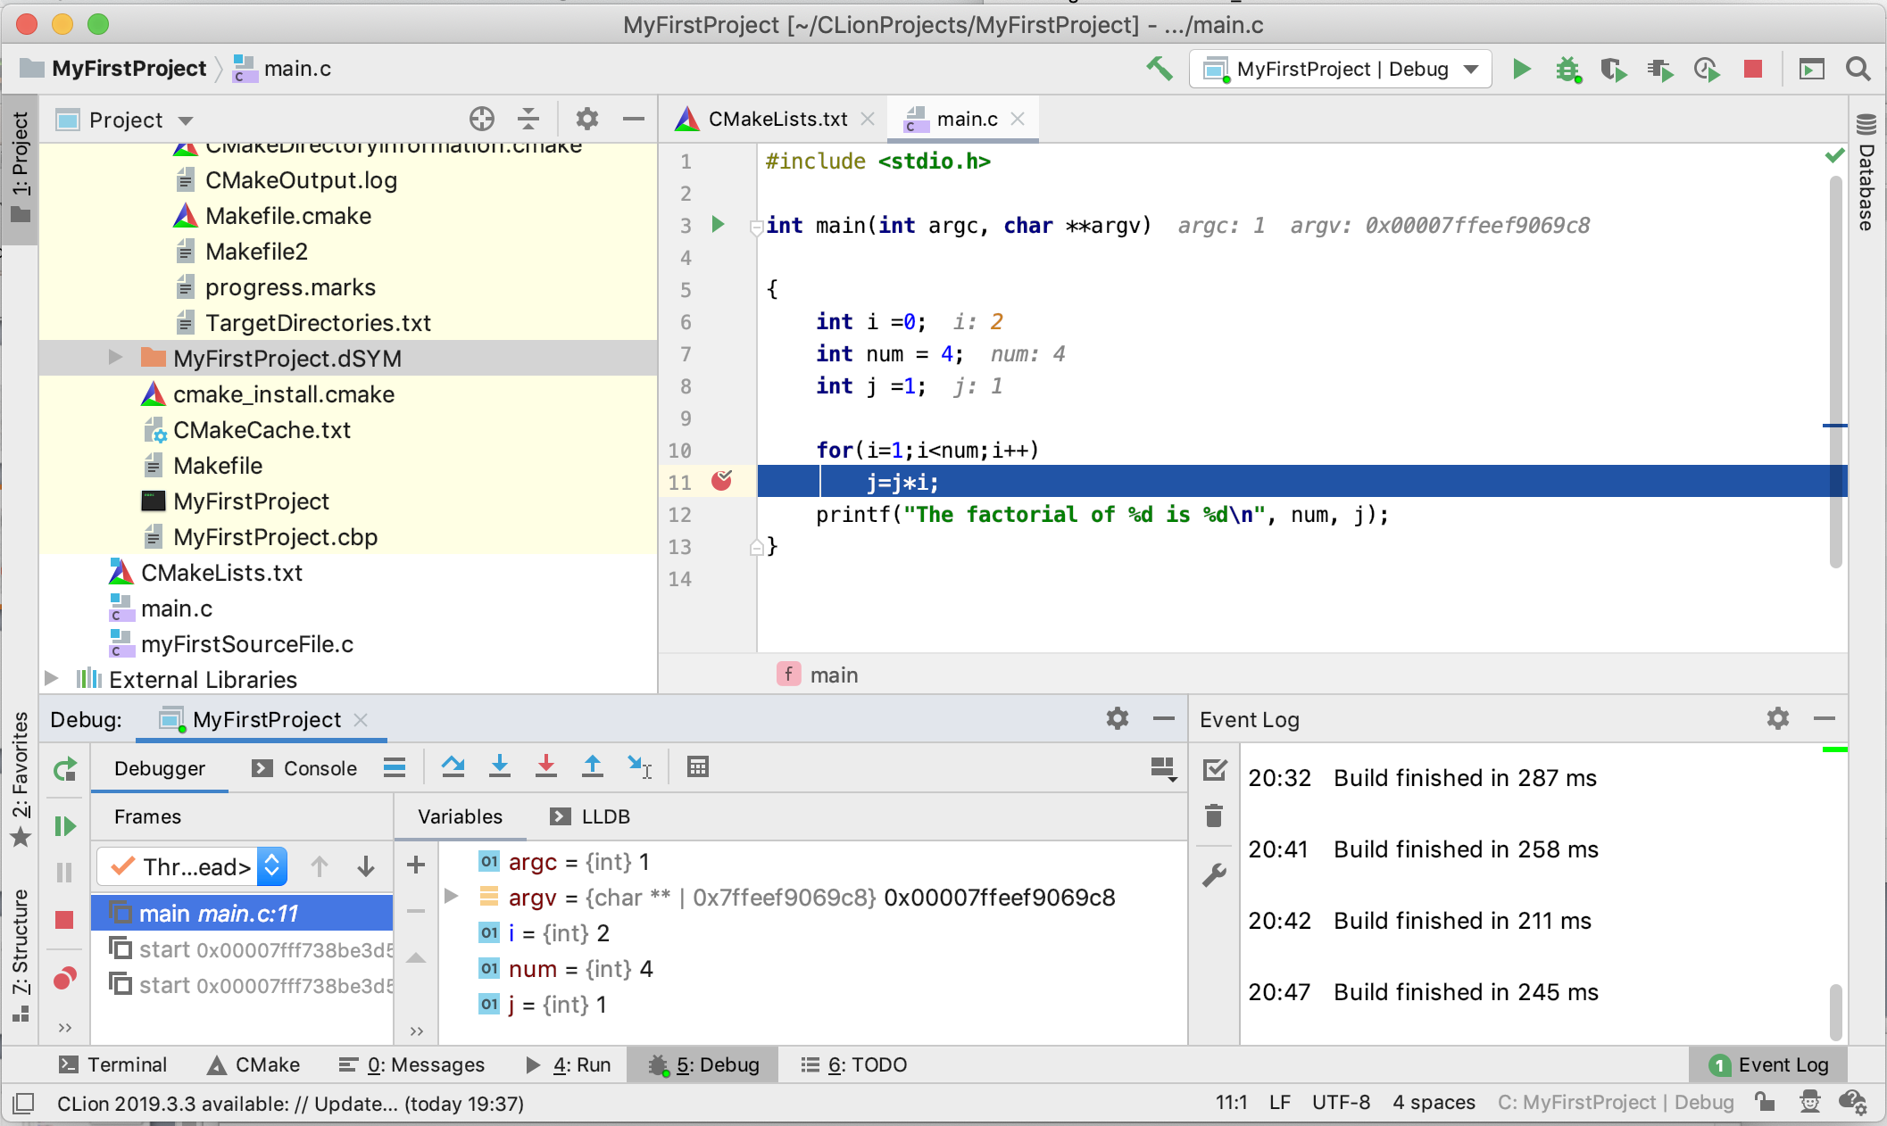
Debugging
Press Debug/Continue

Slide 54
Debugging
Press Resume Program
Press Debug/Continue

Slide 55
Debugging
Press Run Program
Press Debug/Continue

Slide 56
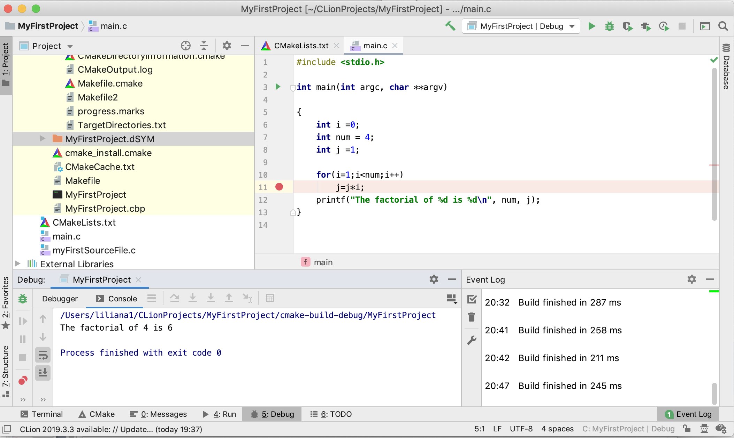
Debugging
This result is wrong.
The program returns the factorial of 3 (the number preceding 4) instead of the factorial of 4!

Slide 57
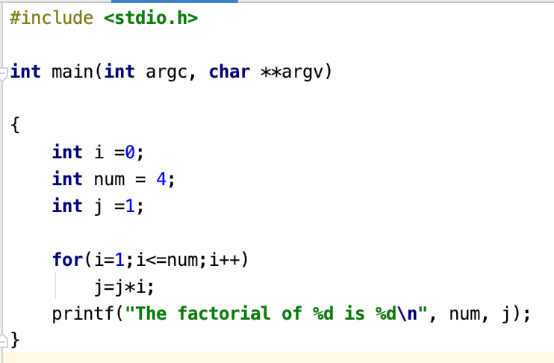
Correct Program
Correct the line of code inside the red square to calculate the factorial of a number correctly.

